Slide 1
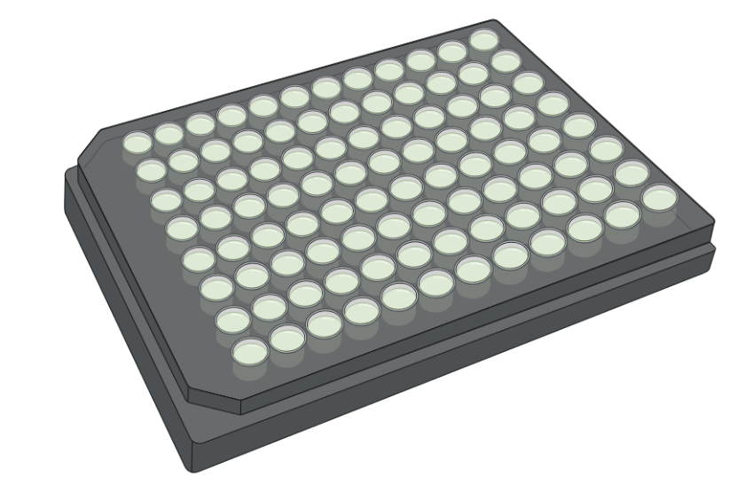
Unveiling virus-host interactions of marine protists through Single-Cell Genomics
Xabier López-Alforja¹*, David López-Escardó¹, ﻿﻿Manuel Martínez García², Sheree Yau³, Ramon Massana¹, Felipe H. Coutinho¹ & Dolors Vaqué¹
*Corresponding author: xabierlopez@icm.csic.es
¹Department of Marine Biology and Oceanography, Institut de Ciències del Mar (ICM-CSIC), Barcelona, Spain
²Department of Fisiologia, Genetica y Microbiologia, Universidad de Alicante (UA), Alicante Spain
³Sorbonne Université, Biologie Intégrative des Organismes Marins (BIOM), Observatoire Océanologique, Banyuls-sur-Mer, France.
WHY STUDY EUKARYOTIC VIRUSES?
Viruses play fundamental roles in ocean biogeochemical cycles, but those infecting protists have often been neglected, despite the fact that their hosts are important primary producers and grazers.
Mining viral genomes in eukaryotic Single Amplified Genomes (SAG) is key for understanding the underlying mechanisms and the specificity of the interactions between eukaryotic viruses and their hosts.
Our aim is to unravel the ecological impact of virus on protist dynamics at Blanes Bay Microbial Observatory (BBMO), Catalunya, Spain.
Single Amplified Genomes (SAGs)
IDENTIFICATION OF NOVEL EUKARYOTIC VIRUSES
Cell-sorting
Multiple Displacement Amplification (MDA)
Filtered surface water sample
Sequentiation
& Assemmbly
A) Giant Viruses (Nucleocytoviricota - NCLDV)
B) Virophages (Lavidaviridae)
Host Supergroup | Host Supergroup
 | Alveolata
 | Archaeplastida
 | Haptista
 | Opisthokonta
 | Rhizaria
 | Stramenopiles
 | Telonemia
 | Unlcassified Eukaryote
AGCGATATTTAAAGGCA
AATTACCG
Light beam
SSC
TATTTAAAGGCA
AGGGCAGCAGTATTA
FCS
Host identification through 18S rDNA and/or V4 hypervariable region
18S rDNA
AGCGATATTTAAAGGCA
AATTACCG
TATTTAAAGGCA
AGGGCAGCAGTATTA
CONTIG ANNOTATION AND HOST LINKAGE
VIRAL CONTIG IDENTIFICATION
AGGTCTGATATTTAAAGGCA
AGGGCAGCAGTATTA
TATTTAAAGGCA
GCAGCAGT
GCAGCAGT
AGGCAGTATTACCG
GCAGCAGT
GCAGCAGT
VIRAL CONTIG
GCAGCAGT
Figure 1. SAGS workflow. The protist cells are sorted from the natural sample one at a time by flow cytometry, which deposits each cell in 96-well plates. Then, the cells are lysed with chemical agents, leaving their DNA free for later amplification (MDA, in real-time). Once, the DNA is in sufficient quantity for sequencing. Once the sequences are assembled and trimmed, hosts are identified by 18s rDNA or HV4. In addition, viruses are identified from these scaffolds. Finally, an annotation of proteins is made to adjust their identification to more specific taxonomic levels.
Figure 2. Number of viral contigs (genome fragments) identified in our SAGs by different host supergroups. Number of contigs of each row are shown as labels right to the bar.
CHARACTERIZATION OF NCLDV MARKER PROTEINS
NOVEL VIRUS DIVERSITY
Polymerase B-based protein phylogenetic tree
Host-virus linkages
Matching viral contigs with reference databases
Table 1. Host-virus linkages of the most representative and conserved groups containing viral contigs
Table 2. Summary of the comparison of our contigs against RefSeq databases (157 NCLDV and 27 Lavidaviridae complete genomes) as well as with GLUVAB3 collection (an uncultured virus database from more than 60 publications), showing how our virus sequences are considerably different from those in the reference databases. The low number of matches (query/subject), and low AAI and Matched CDS percentages
HOST | nº of contigs | Total length (bp) | Best Hit Family | Best Hit Genus | Marker Proteins
* MAST-3G-sp1 | 9 | 316641 | Phycodnaviridae | Prymnesiovirus | PolB
 |  |  |  |  | mRNAc
 |  |  |  |  | RNAPL, RNAPS, RNAPS
 |  |  |  |  | mcp
 |  |  |  |  | RNR, SFII
* MAST-1D-sp2 | 3 | 30528 | Phycodnaviridae | Prasinovirus | mcp, PolB
 |  |  |  |  | A32
MAST-1D-sp2 | 1 | 9520 | Phycodnaviridae | Prasinovirus | -
MAST-1D-sp2 | 1 | 13193 | Phycodnaviridae | Prasinovirus | -
StramenopileNA-sp2 | 7 | 553030 | Phycodnaviridae | Prymnesiovirus | RNR
 |  |  |  |  | RNAPS, RNAPS
 |  |  |  |  | mcp, mRNAc
ChrysophyceaeG-sp2 | 7 | 66793 | Phycodnaviridae | Prymnesiovirus | mRNAc
ChrysophyceaeNA-sp1 | 3 | 33271 | Phycodnaviridae | Prymnesiovirus | -
ChoanoflagellateD-sp1 | 2 | 13909 | Phycodnaviridae | Prasinovirus | mRNAc
Picozoa-sp1 | 1 | 13493 | Phycodnaviridae | Prymnesiovirus | -
Prymnesiophyceae-sp1 | 2 | 24101 | Phycodnaviridae | Prasinovirus | A32
Micromonas-sp1 | 1 | 11398 | Phycodnaviridae | Prymnesiovirus | mRNAc
*
 | DB | nº query scaffolds | nº subject scaffolds | AAI | Matched CDS | Perc Matched CDS
NCLDV | RefSeq | 15 | 76 | 56,96 | 7,30 | 51,43
 | GLUVAB | 35 | 6484 | 57,15 | 4,90 | 43,39
Lavidaviridae | RefSeq | - | - | - | - | -
 | GLUVAB | 25 | 2158 | 58,17 | 4,81 | 50,67
*
Gene organization of representative viral contigs
AH6175_contig_1_length_118527
RNAP
RNAP
AAA
Pol B
Dihydrofolate reductase
RNAP
AAA
Helicase
20kb
40kb
60kb
80kb
Helicase SFII
100kb
AH6175_contig_2_length_76030
Pol B
DEAD Helicase
AAA
20kb
NCLDV capsid
30kb
NCLDV capsid
40kb
70kb
AH6172_contig_175_length_9327
5kb
6kb
7kb
8kb
Pol B
9kb
Replication and repair
- Helicases and Topoisomerases
Figure 5. Scatterplot of the best hits in our NCLDV contigs against the RefSeq databases where few scaffolds share proteins with databases, presenting fairly low Amino Acid Identities. Different colours show the best hits of taxonomic annotation via RefSeq, even with low AAI.
Metabolism of cofactors and vitamins
- Dihydrofolate reductase
Carbohydrate metabolism
- Glycosyltransferases and glucose dehydratases
Transcription
- DNA-directed RNA pol
Cell growth
- ATPases (AAA) and ABC transporter proteins
Figure 3. Polymerase B-based protein phylogenetic tree. PolB protein sequences derived from RefSeq Databases. Our contigs, shown in red, are located within the Phycodnaviridae family.
Figure 4. ﻿Example of localization of genes on genomic contigs from three representative NCLDV. We found a wide range of proteins involved in multiple cellular processes in their interaction with the host. (Figure 4), in agreement with Moniruzzaman et al. (2020) for this type of virus.
TAKE HOME MESSAGE
REFERENCES
Our data offer clear evidence for the effectiveness of using SAG as an approach to establish virus-host linkages, as well as the characterization of new, previously undescribed viruses that infect any other organism. In addition, it suggests that protists are likely to interact with predominantly specialized viruses.
The lack of references or similarity of our contigs to those previously collected in the databases raises the possibility of a specific taxonomic characterization of the novel virus.
Moniruzzaman, M., Martinez-Gutierrez, C. A., Weinheimer, A. R., & Aylward, F. O. (2020). Dynamic genome evolution and complex virocell metabolism of globally-distributed giant viruses. Nature Communications, 11(1710), 1–11. https://doi.org/10.1038/S41467-020-15507-2
Paez-Espino, D., Zhou, J., Roux, S., Nayfach, S., Pavlopoulos, G. A., Schulz, F., McMahon, K. D., Walsh, D., Woyke, T., Ivanova, N. N., Eloe-Fadrosh, E. A., Tringe, S. G., & Kyrpides, N. C. (2019). Diversity, evolution, and classification of virophages uncovered through global metagenomics. Microbiome, 7(1), 1–14. https://doi.org/10.1186/s40168-019-0768-5
Schulz, F., Roux, S., Paez-Espino, D., Jungbluth, S., Walsh, D. A., Denef, V. J., McMahon, K. D., Konstantinidis, K. T., Eloe-Fadrosh, E. A., Kyrpides, N. C., & Woyke, T. (2020). Giant virus diversity and host interactions through global metagenomics. Nature, 578(7795), 432–436. https://doi.org/10.1038/S41586-020-1957-X

