Slide 1
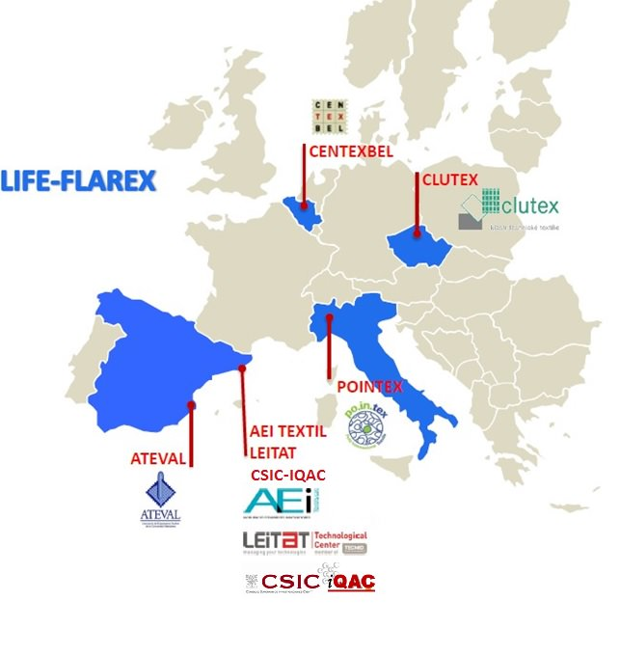
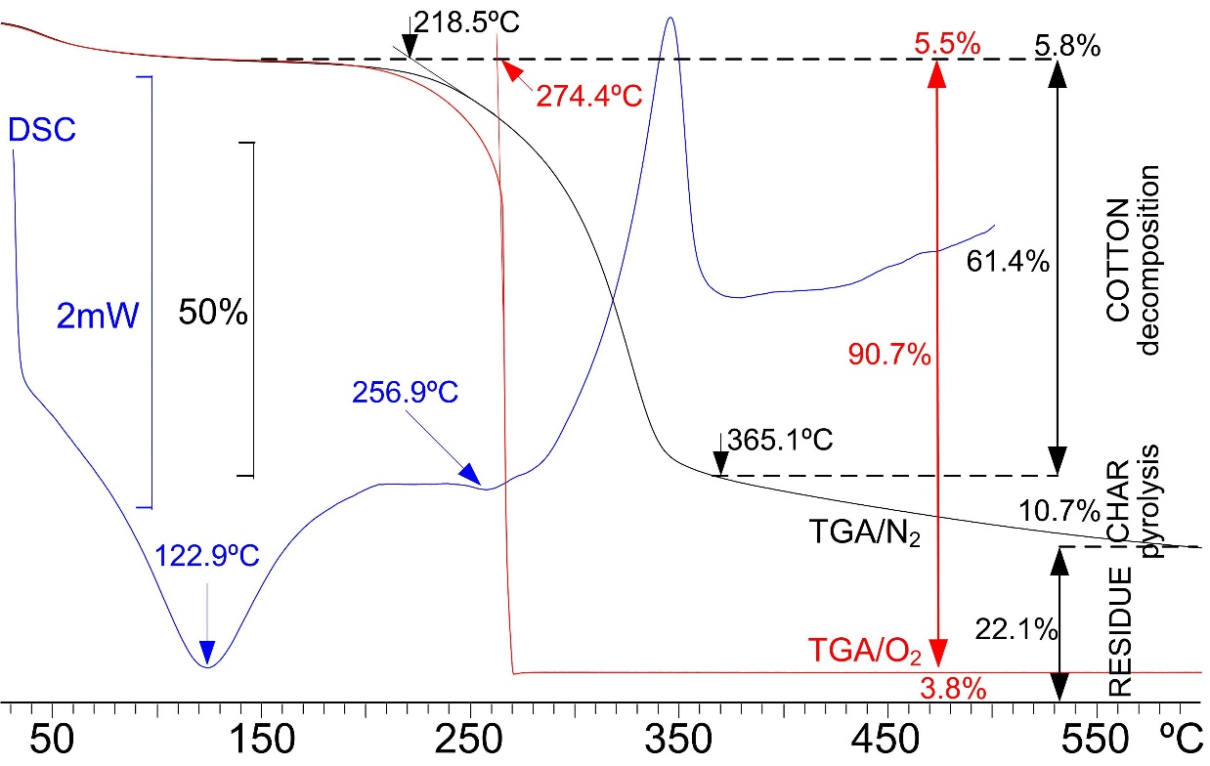
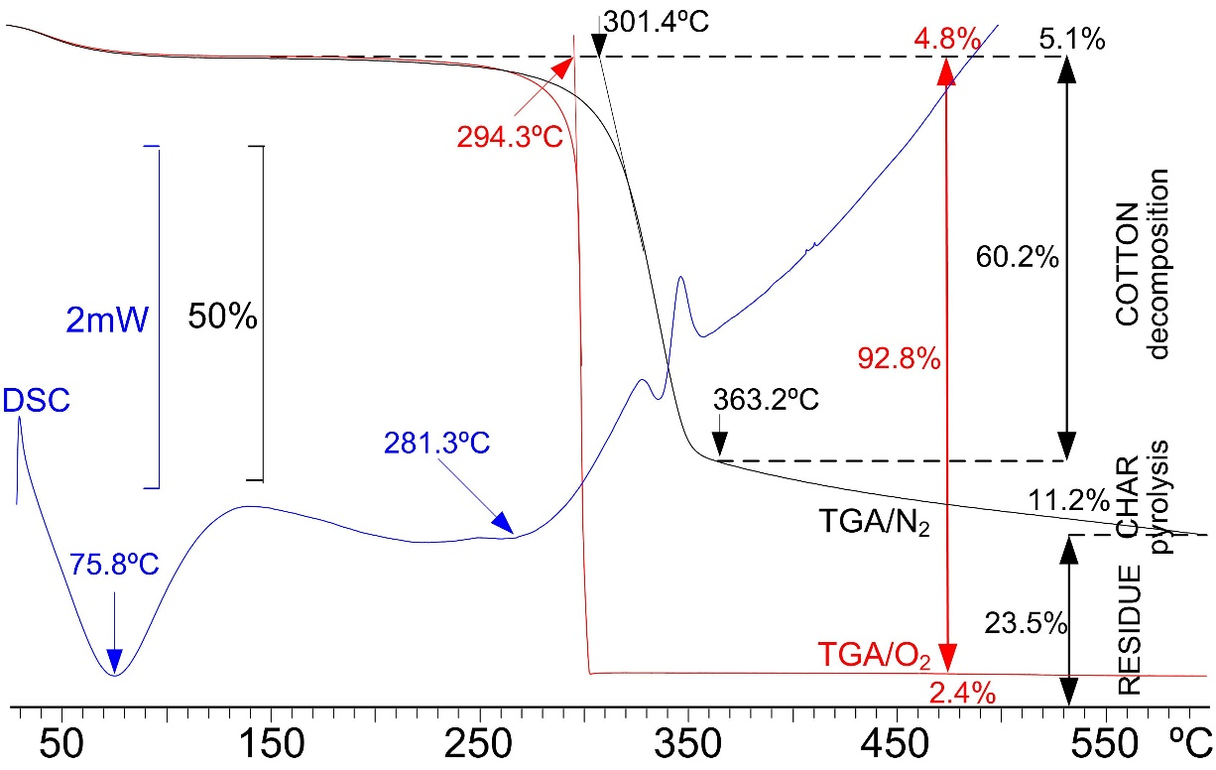
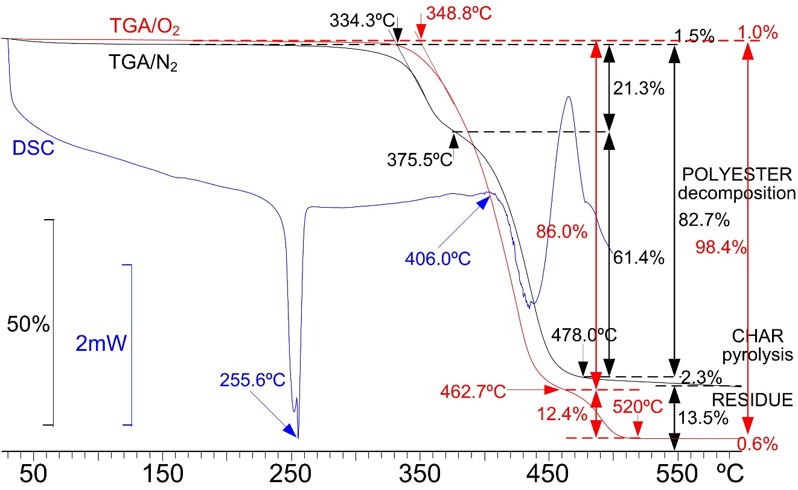
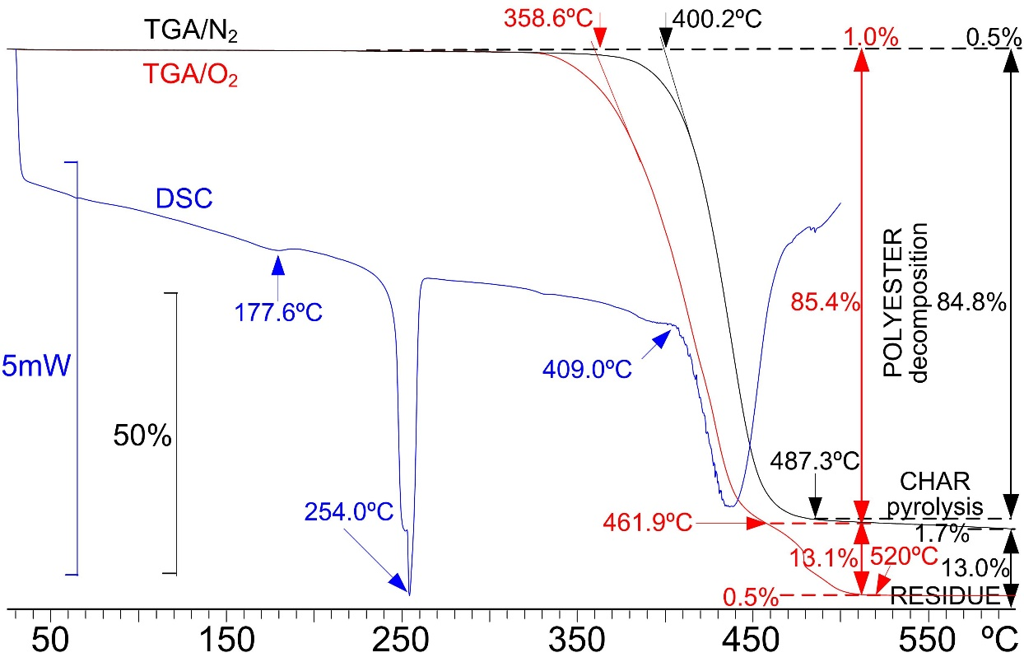
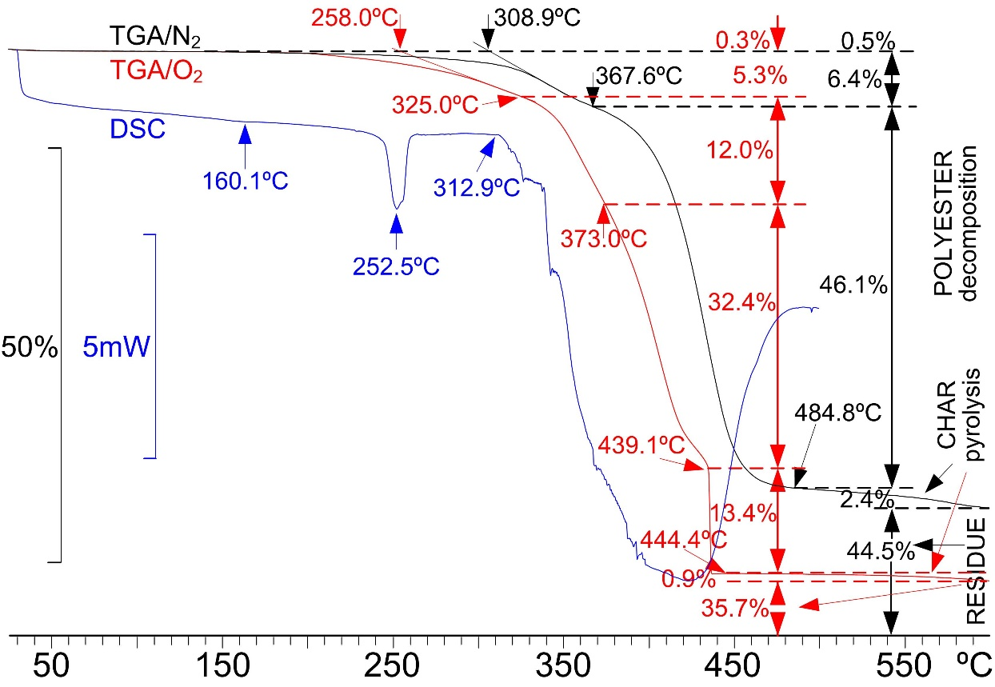
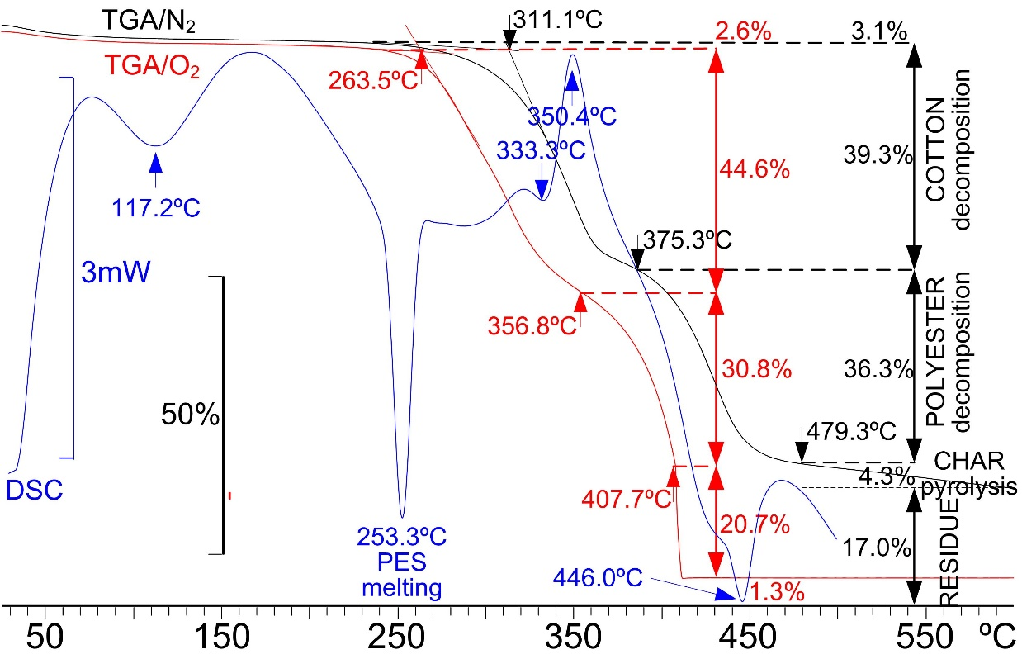
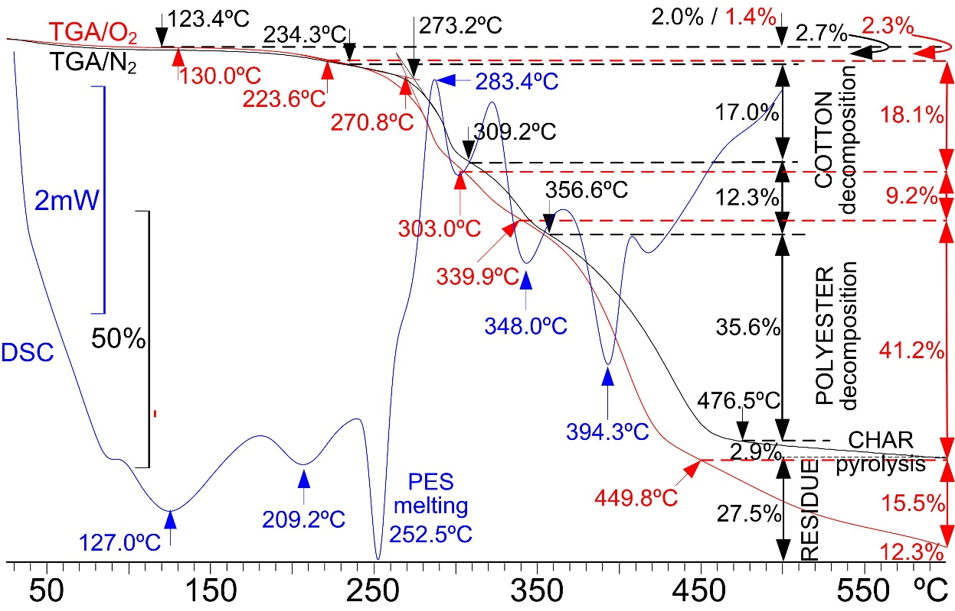
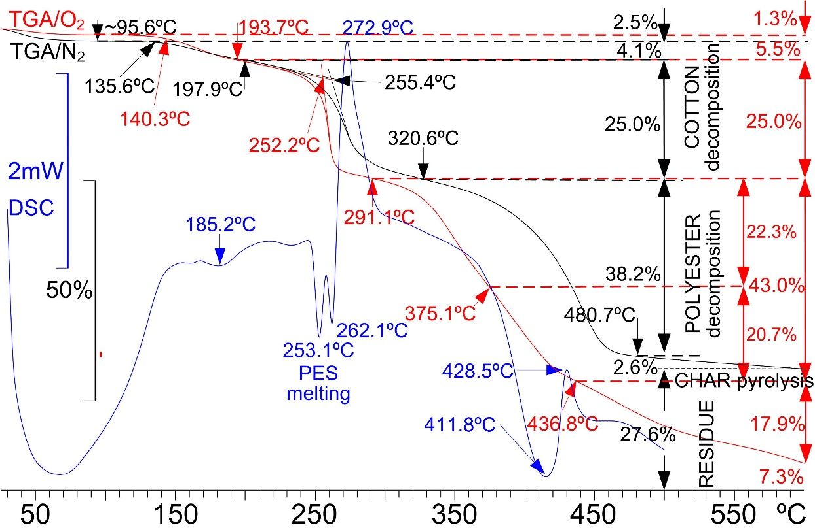
EVALUATION OF HEALTHY AND ECOLOGICAL FRIENDLY
FLAME RETARDANTS FOR TEXTILES USING THERMAL ANALYSIS
Albert M MANICH; Sonia PÉREZ-RENTERO; Cristina ALONSO; Luisa CODERCH; Meritxell MARTÍ
Institute of Advanced Chemistry of Catalonia, IQAC-CSIC, Barcelona, Spain
albert.manich@iqac.csic.es
CEEC-TAC5 & Medicta 2019 Joint Conference
ABSTRACT FLAREX : PROJECT OBJECTIVES - PARTICIPANTS
Flame Retardants (FR) are a group of anthropogenic environmental contaminants used at a relatively high concentration in many applications. Currently, the largest marked group of FRs is halogenated FR, and many of them are considered toxic, persistent and bio accumulative. Non-halogenated alternatives are a possible solution for the problem, but there is a lack of knowledge concerning environmental impact, health risks during the production process and final use.
The main objective of this work is the mitigation of the environmental and human health impacts of flame retardants in textile applications looking for new efficient alternatives able to replace the most common FR applied in textile finishing, based on substances with toxic compounds which contain halogens, formaldehyde and antimony (1, 2).
In the framework of the LIFE-FLAREX project, new more ecological and healthy alternatives are being proposed, and the determination of the thermal stability has been made by DSC and TGA. In this work, the thermal stability of the new FR for cotton and polyester fabrics have been measured and the results have been compared with those given by the best FR applied to cotton/polyester blended fabric (3).
The thermal behaviour of the treated and non-treated fabrics using the different more ecological alternatives have been measured by differential scanning calorimetry DSC up to 550ºC and thermogravimetric analysis TGA up to 600ºC in N₂ and O₂ atmospheres because the obtained results are in accordance with those given by the micro-scale combustion calorimeter [4]. Flame retardants based on expandable graphite, dialkil phosphono carboxylic acid amide and decabrome diphenyl ethane with antimony trioxide are analysed, and the results are compared with those given by the application of ammonium polyphosphate and guanidine phosphate to a cotton/polyester 50/50 blend [3].
LIFE-FLAREX AIMS TO CARRY OUT AN ANALYSIS OF THE ENVIRONMENTAL IMPACT OF THE BEST TECHNOLOGIES CURRENTLY AVAILABLE TO REPLACE THE TOXIC FLAME RETARDANTS (FRS) USED IN TEXTILE FINISHING PROCESSES.
THE PROJECT WILL FOCUS ON THOSE THAT ARE HALOGENATED, CONTAIN ANTIMONY OR ARE FORMALDEHYDE-RELEASING, AND TRY TO LOOK FOR THE BEST ALTERNATIVES:
LESS TOXIC FR’s WITH LOWER ENVIRONMENTAL IMPACT BUT KEEPING AT THE SAME TIME THE REQUIRED FIRE RETARDANCY PROPERTIES OF THE FABRIC.
www.life-flarex.eu
The OBJECTIVE OF THIS WORK is to measure the effect of a conventional FR based on decabromo diphenyl including Sb₂O₃ on the thermal behavior of cotton, the effect of dialkyl phosphono carboxylic acid amide and that of expandable graphite on the thermal behavior of polyester and compare the results with those given by the ammonium polyphosphate and guanidine phosphate, on the thermal behavior of a polyester/cotton fabric.
INTRODUCTION
The low thermal stability, easy ignition and rapid combustion of cellulose fibres represent a weaknesses and limitation in the production of fire-protective textiles when they are blended with synthetic fibres. Consequently, the application of flame retardants has been traditionally focussed on their effect on cellulosic fibres. Flame retardants are applied to decrease the combustible power of textiles and favour the release of inert volatiles [1]. The toxicity and the environmental impact of halogenated flame retardants turn aside the interest for halogen-free flame retardants based on more healthy and environmental friendly alternatives like intumescent flame retardants (IFR) based on ammonium polyphosphates and expandable graphite that act as a blowing agent that limits mass and heat transfer, oxygen diffusion and smoke suppressor.
The application of thermal analysis techniques enables to asses the effect of the flame retardants on thermal stability and final residue at 600ºC in N2 and O2 atmospheres. The results are in accordance with those of the heat release rate given by a micro-scale combustion calorimeter MCC related by Qin Chen and Tao Zhao [2].
RESULTS: DSC ( − ) TGA in N₂ atmosphere ( − ) TGA in O₂ atmosphere ( − )
MATERIALS AND METHODS (see ref. 3)
CONCLUSIONS
1- DIFFERENTIAL SCANNING CALORIMETER DSC Mettler-Toledo DSC 823
2- THERMO GRAVIMETRIC ANALYSIS TGA Mettler-Toledo TGA/SDTA 840
3- SAMPLES: Cotton (CO), Polyester (PES), 50/50 Cotton/Polyester blend (CO/PES)
a) CO linen (reference material).
b) CO linen treated with dialkyl phosphono carboxylic acid amide (add-on 0.7%)
c) PES upholstery (reference material)
d) PES upholstery treated with decabromo diphenyl ethane + Sb₂O₃ (add-on 11.5%)
e) PES upholstery treated with expandable graphite (add-on 35%)
f) CO/PES mattress ticking (reference material) [3]
g) CO/PES mattress ticking treated with a FR based on guanidine phosphate [3]
h) CO/PES mattress ticking treated with a FR based on ammonium polyphosphate [3]
a) NON TREATED COTTON
b) Dialkyl phosphono carboxylic acid amide
The application of thermal analysis (TGA and DSC) to evaluate the influence of flame retardants on the thermal stability of cotton, polyester and 50/50 cotton/polyester fabrics enable to conclude the following about the different types of flame retardants used:
Conventional FR’s applied on
Cotton: The FR based on DPCAA (sample b) increases the thermal stability by 20º in O₂ and 80ºC in N₂ although the final residues at 600ºC are similar to that of the non-treated fabric regardless the atmosphere.
Polyester: The FR based on DBDE+Sb₂O₃ (sample d) increases the thermal stability by 10º in O₂ and 65ºC in N₂ although the final residues at 600ºC are also very similar with that of the non-treated fabric regardless the atmosphere.
Ecological Intumescent FR’s applied on
Cotton/Polyester blend: The IFR based on APP (sample h) showed the highest protective effect on cotton. It decreases the initial temperature of decomposition favouring the release of inert volatiles and increases the final residue at 600ºC (7,3% in O₂ and 27.6% in N₂).
Polyester: The IFR based on expandable graphite (sample e) slightly decreases the initial temperatures of decomposition in O₂ and N₂ and yields the highest increase in the final residue at 600ºC (35,7% in O₂ and 44.5% in N₂).
Other Ecological FR’s applied on
Cotton/Polyester blend: The FR based on Guanidine Phosphate (sample g) showed a higher protective effect than that shown by the IFR based on Ammonium polyphosphate because it shows a higher final residue at 600ºC in O₂ (12.3%) with a very similar result in N₂ (27.5%).
Depending on the final application of textiles (clothing, upholstery, home textiles) guanidine phosphate and expandable graphite can be considered as good potential ecological alternatives to the conventional FR’s.
c) NON TREATED POLYESTER
d) Decabromo diphenyl including Sb₂O₃
e) Expandable graphite
f) NON TREATED CO/PES BLEND
g) Guanidine phosphate
h) Ammonium polyphosphate
Acknowledgement: Authors wish to thank the LIFE Environmental Policy and Governance program from the European Union for its financial contribution to the FLAREX-LIFE project (LIFE16 ENV/ES/000374).
References
[1] A Manich (1961): Aprestos y acabados de fibras textiles. Dalmau y Jover, Barcelona, pp.267-269
[2] AM Manich, MH Ussman Eds. (2002): Updating the ‘cottonized’ flax processing. ISBN-972-9209-93-6. Universidade da Beira Interior, Covilhã, pp 178-191.
[3] AM Manich, C Alonso, S Pérez-Rentero, L Coderch, M Martí. Thermal Analysis (DSC, TGA) of textile flame retardants with lower environmental impact. AUTEX2019 – 19th World Textile Conference on Textiles at the Crossroads, 11-15 June 2019, Ghent, Belgium
[4] Qin Chen, Tao Zhao. The thermal decomposition and heat release properties of the nylon/CO, polyester/CO and Nomex/CO blend fabrics; Text Res J 2015, 86, 1859-1868
Authors also thank the other partners of FLAREX consortium for their work, specially LEITAT & CENTEXBEL for their valuable contribution.

